Slide 1

“STOCK INVENTORY WEBSITE”
Task - 3

Slide 2
STOCK INVENTORY WEBSITE
Stock Inventory website stores the product details and also the stock. It provides the interface to users to manage the daily transaction and the previous data. It maintenances the report about the monthly inwards ,monthly returns and monthly deliveries.
LMS Username | Name | Batch
2115a91 | AARTHY.K | A9
2115a92 | AASHA.M | A9
2115a916 | DHANU SRI M.R | A9
2115a946 | SNEGAA.S | A9

Slide 3
Task 3 :: Frontend Creation
Create various Front End Programs
Draw and design a uniform front end code for “Your Project”
Draw and design a interactive front end code for “Your Project”
Evaluation Metric:
100% Completion of the above tasks
Learning outcome
Developing complicated UI using HTML components
Using props drilling and context to pass variables
Getting familiar with different type of api calls
Handling different input data

Slide 4
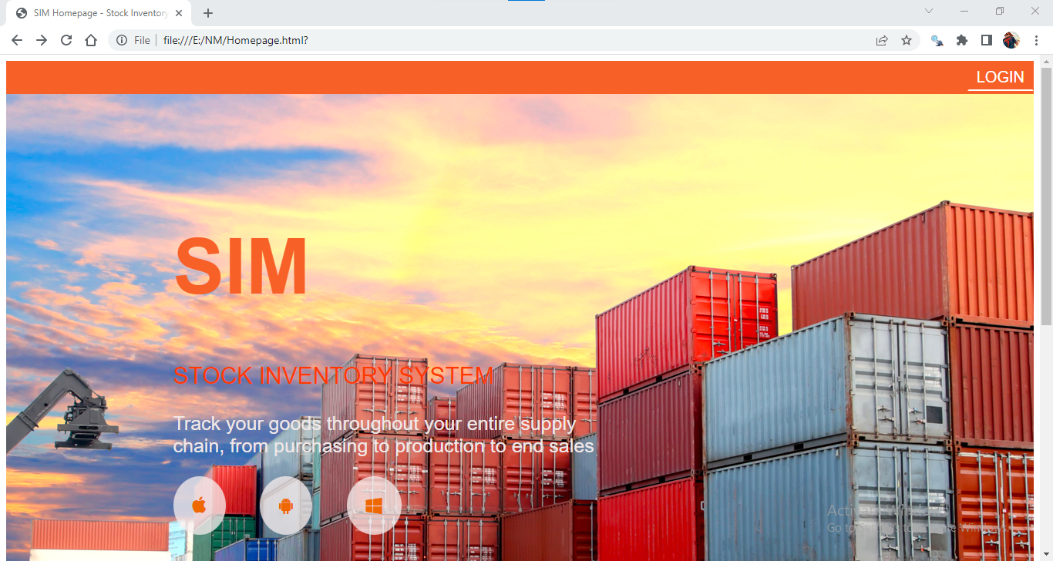
OUTPUT:

Slide 5
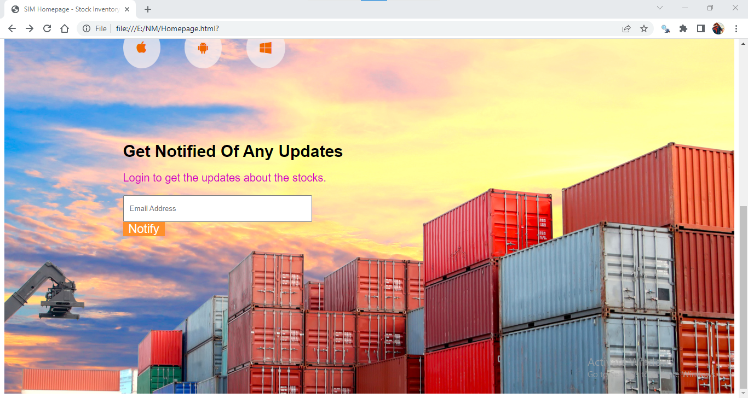

Slide 6


Slide 7
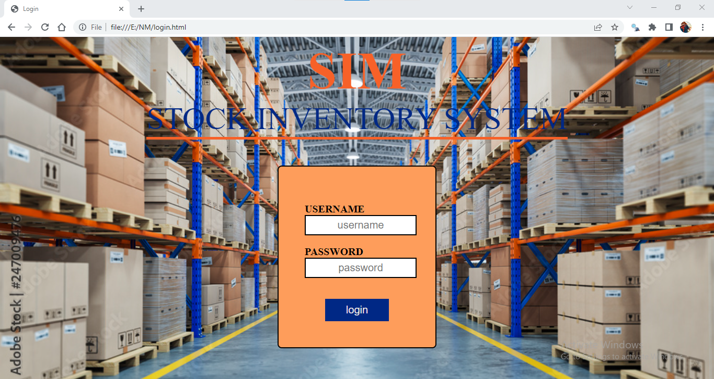

Slide 8
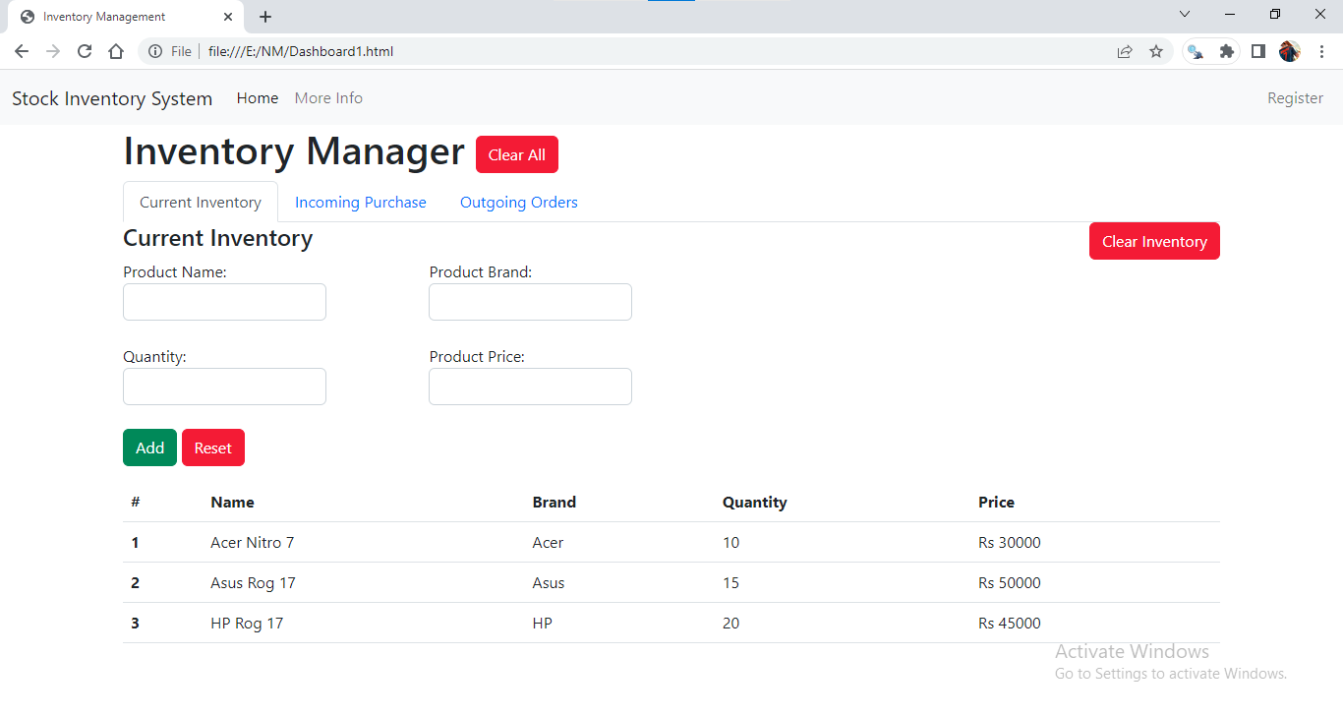

Slide 9
Assessment Parameter
Create folder structure for HTML application
Render Conditional components
Write Functions for event handling
Check-List
Overall UI of the project
Handling broken links
Optimizing render cycle

Slide 10
Submission Github
https://github.com/aarthy03/Stock-Inventory-Website

